Slide 1

HCL: Driving Digital Transformation
Presented by: shantung chaudhary
HCL is a global IT services company focused on innovation and technology solutions.

Slide 2
Introduction
HCL Technologies is a multinational IT services company.
Provides software, IT consulting, and business solutions.
Operates in 50+ countries.
Headquarters: India.

Slide 3
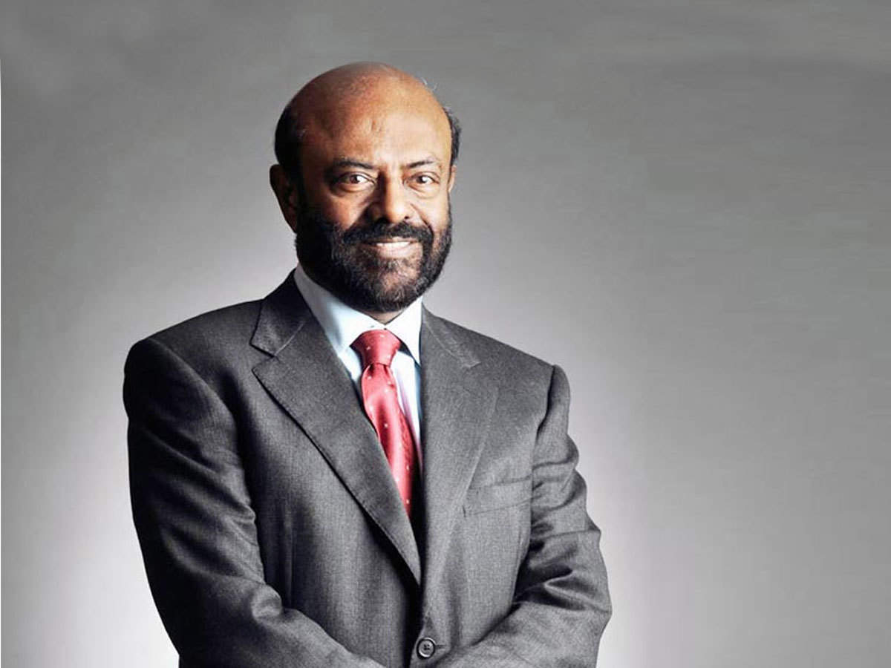
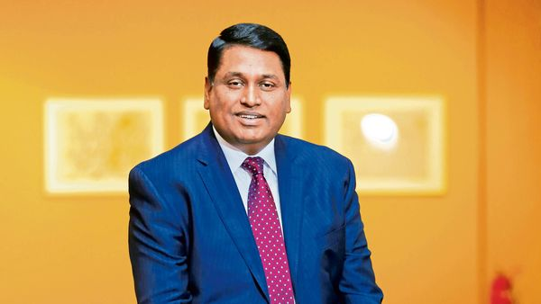
Founders & Leadership
Founded by Shiv Nadar in 1976.
Current CEO: C. Vijayakumar.
Strong leadership driving digital transformation.

Slide 4
Company History
1976
Founded as Hindustan Computers Limited.
1990s
Entered IT services.
2000s
Global expansion.
Present
Leading IT services company.

Slide 5
Programming & Technologies
Uses multiple technologies:
Java, Python, C++, Cloud Tech.
Focus on AI, ML, Cloud, Cybersecurity.

Slide 6
Mission & Vision
Mission: Deliver value through innovation.
Vision: Become global leader in digital transformation.
Focus on growth & technology.

Slide 7

Nature of Business
IT services & consulting company.
Focus on enterprise solutions.
Strong R&D and innovation.

Slide 8

Major Services
IT Services
Cloud Computing
Cybersecurity
AI & Data Analytics
Engineering Services

Slide 9
Cloud Platform
HCL provides cloud services and solutions.
Partners with AWS, Azure, Google Cloud.
Helps businesses migrate to cloud.

Slide 10
Latest Technologies
Artificial Intelligence
Machine Learning
Cloud Computing
IoT
Big Data Analytics

Slide 11
Achievements
Global IT leader.
Strong client base.
Recognized for innovation.
Consistent growth.

Slide 12
HCL in India
Major offices in Noida, Bangalore, Chennai.
Large workforce.
Major IT hiring hub.

Slide 13
Competitors & Challenges
Competitors: TCS, Infosys, Wipro.
Challenges: Competition, security, rapid tech change.

Slide 14
Advantages & Future Scope
Strong global presence.
Innovation driven.
Future growth in AI, cloud, automation.

Slide 15
Why HCL is Best?
Trusted IT partner.
Strong digital solutions.
Global reach.
Continuous innovation.

Slide 16
Conclusion
HCL is a global IT leader.
Strong in digital transformation.
Future-focused company.

Slide 17

Thank You

